Slide 1
Financial Loan Risk Assessment
Presented by: Gloria Lagrand | Michael Elbaz
Adriana Brazon | Darcee Caron

Slide 2
Dataset
Source: Kaggle, fictional data
Approximately 32k rows
12 features
1 record= 1 loan record/client

Slide 3
Data Preparation
Cleaning
Dummying, transforming non-numerical columns
Train/Test Split + Scaling
Removing duplicate rows
Age: deleting the values > 122
Employment length: deleting values > 80
Drop rows with Na
Drop rows where interest rate = 0%
One hot / label encoding
cb_person_default_on_file: Y/N → 0/1
loan_grade: from A to E
Person_home_ownership: Own, Rent, Mortgage
Loan_intent: various reasons / intents
X_train, X_test, y_train, y_test - test_size=0.20, random_state=0
normalizer = MinMaxScaler()

Slide 4
Learnings
Process & Test Selection
Feature selection and DF creation where possible before creating dummies
Generating new DF with appropriate names along the way
Attention to appropriate models & formulae for classification vs. regression problems

Slide 5
Models Tested
Classification
Target = Loan Status → Profile of clients more/less likely to default
Target = Loan Intent → Profile of clients more/less likely to take given loan type
Target = cb_person_default_on_file → Profile of clients historically defaulters
Regression
Target = Loan Amount → Association of loan amount to other numerical indicators
Target = Loan grade → Association of loan grade to other numerical indicators

Slide 6

Target:Loan Status
Feature Selection: Eliminated loan grade
Transformations: One hot encoding of all categorical data
Feature Scaling: min/max scaler
Trained 7 Models: KNN, Decision Tree, Logistic Regression, Bagging & Pasting, Random Forest, Ada Boosting, & Gradient Boosting
Model Selection Using Weighted Average F1 Score
1. Random Patches Test: weighted average F1 score = 0.92
2. Gradient Boosting Test: weighted average F1 score = 0.92
Recall for Random Patches = slightly higher = may be better capturing true positive instances (correctly id loan defaults)
Random Patches
Winning Model & why
Application
Further work: fix the balance

Slide 7
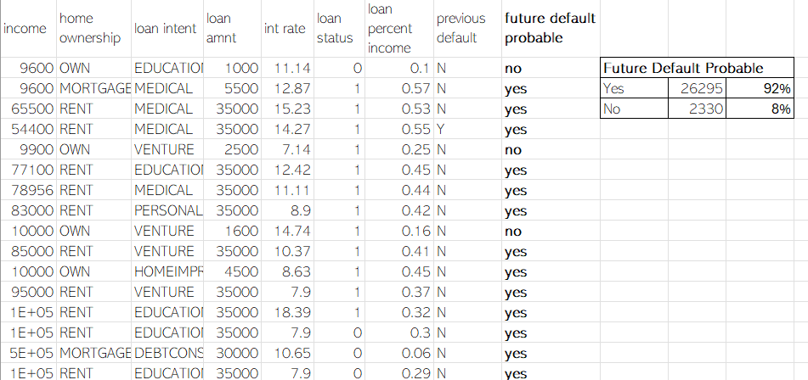
Application:Loan Status Target
Client Profiles
Prediction: Future Default
Low default risk
Higher income
Lack of previous default
Home mortgage
Home owner
Client Profiling : Using correlation coefficients, clients most and least likely to default
Default Status Prediction: Use model to predict the likelihood of a client defaulting in the future.
High default risk
Loan higher % income
Home renters
Previous default
Higher Interest Rate

Slide 8
Target:cb_person_default_on_file
Feature Selection: No specific selection
Transformations: One hot encoding of all categorical data
Feature Scaling: min/max scaler
Trained 7 Models: KNN, Decision Tree, Logistic Regression, Bagging & Pasting, Forest Tree, Ada Boosting, & Gradient Boosting
Model Selection using Recall
1.Bagging Classifier w/ undersampled data : Recall score for
class 0 = 0.88
2. Random Forest : Recall score for class 0 = 0.90
But also setting a minimum threshold for Recall classe 1 = 0,50
Successful models

Slide 9
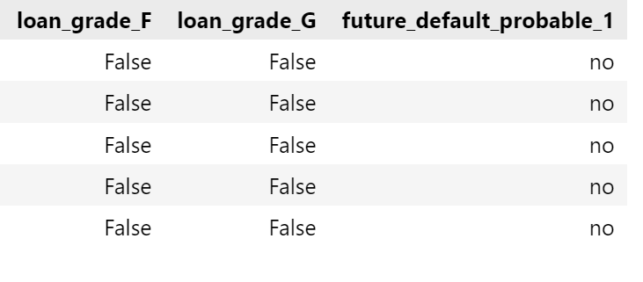
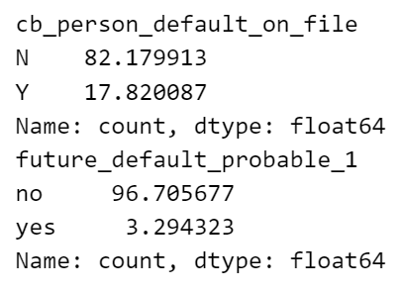
Application:cb_person_default_on_file
Client Profiles
Prediction: Future Default
Low default risk
Higher income
Lack of previous default
Home mortgage
Home owner
Client Profiling : Using correlation coefficients, clients most and least likely to default
Default Status Prediction: Use model to predict the likelihood of a client defaulting in the future.
High default risk
Loan higher % income
Home renters
Previous default
Higher Interest Rate

Slide 10

Target:Loan Intent
Feature Selection: Eliminated loan grade
Transformations: The target variable loan_intent is encoded using LabelEncoder, and other categorical variables are one-hot encoded
Feature Scaling: min/max scaler
Trained 7 Models: KNN, Decision Tree, Logistic Regression, Bagging & Pasting, Random Forest, Ada Boosting, & Gradient Boosting
3 examples Model Assessment Using Accuracy F1 Score
1. Logistic Regression Test: accuracy F1 score = 0.23
2. Decision Tree Test: accuracy F1 score = 0.24
3. Bagging & Pasting Test: accuracy F1 score = 0.24
No successful tests

Slide 11
Target:Loan Amount
Feature Selection: Developed 2 DF with different feature selection
Transformations: One hot encoding of all categorical data
Feature Scaling: min/max scaler
Trained 5 Models: KNN, Linear Regression, Decision Tree, Bagging & Pasting, Random Forest
Model Selection Using Weighted Average R2 Score
KNN: R2 = 0.94 | Decision Tree: R2 = 0.92 | Linear Regression: R2 = 0.92
Bagging: R2 = 0.99987 | Random Forest = 0.99999
Random Forest

Slide 12
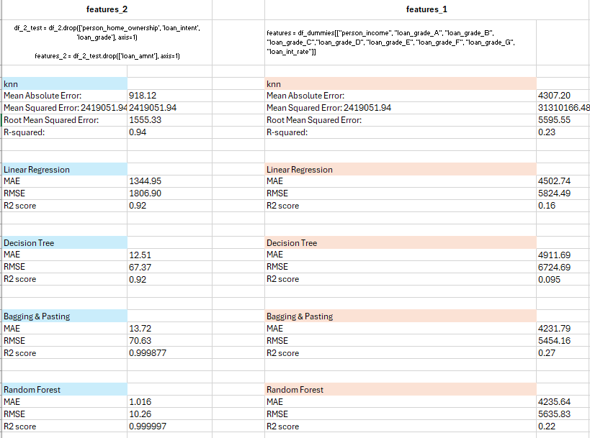

Slide 13
Application:Loan Amount
Loan Product Development & Marketing – Customer Segmentation
Age Segmentation: Loan products tailored to age groups
Income Segmentation: Marketing strategies for customers in various income brackets
Adapting the speech depending on the reason of the loan the customer comes for (education, home, venture, medical)
Interest Rates: Strategies for interest rate assessment on a function of loan amount

Slide 14







Thank You!
Michael
Elbaz
Adriana Brazon
Gloria
Lagrand
Darcee
Caron

